Slide 1

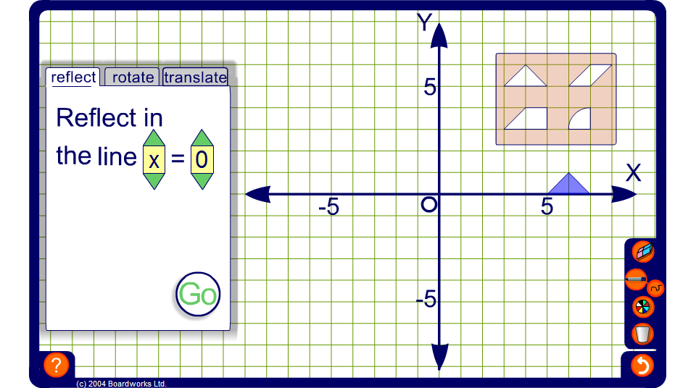

Transformation shape sorter
Notes:
The object of this activity is to use a combination of transformations to fit each shape into its matching hole in as few moves as possible.
Reflections can be through any horizontal of vertical line, rotations can be 90°, 180° or 270° around a chosen point and translations can be a given number of units right (negative for left) or up (negative for down).

